Slide 1
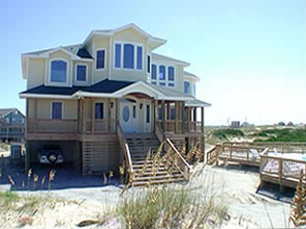
Welcome to
The Carova Heights
2076 Sandfiddler Road
Carova Beach, N.C.
On the Outer Banks
A Guide to a Better Vacation
© Carova Heights LLC 20011

Slide 2
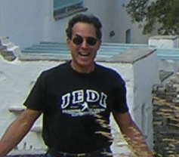
Our House is Your House
In Greece the word “xenia” for “guest” is also the word for “friend.” It also indicates hospitality—all qualities we embrace, and sentiments rental companies rarely deliver.
You’re renting from Rande Joiner, and Robert Honig who genuinely love Carova Heights. We will do our best to share that experience with you, your family and friends.
We will do everything that we can to make your stay at Carova Heights all that you hoped it would be. We hire good people to maintain the property and serve our guests. As you’ll see from the list of things we provide, we go the extra mile.
From time to time, things may not go as we might like. If a problem should arise, we will do our very best to help you solve it quickly and completely. This guide should provide the names and numbers you may need.
We’ve also shared many of the wonderful items we’ve collected over the years. In return, we ask that when you make yourself at home, you do your best to preserve a special place as you found it.
Hopefully, in this spirit of mutual respect we can enjoy the Carova Heights for many years to come.
Cheers, Rande, Bob

Slide 3

Table of Contents
Our House is Your House…………...page 2
Getting To Carova Beach……………page 4
Up the Beach to Carova Heights………page 5
4WD RENTALS & Parking…………page 6
Off Road Driving…………………….page 7
What We Provide…………………….page 8
What to Bring………………………..page 9
On Arrival: Keypad, Unloading, etc. ..page 10
Things to Know………………………page 11
Emergency & Contact Numbers……..page 12
Pet Policy…………………………….page 13
Pool & Hot Tub………………………page 14
Do’s and Don’ts…………………… page 15
Check Out & Prep……………………page 16
Finding the Fun Stuff…………………page 17
Travel Insurance………………………page 18
Overview of 4WD Beach Entry………page 19
Our Beach Access……………………page 20
View of Carova Heights Surrounding…page 21

Slide 4
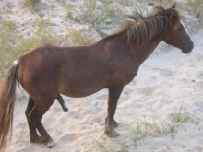
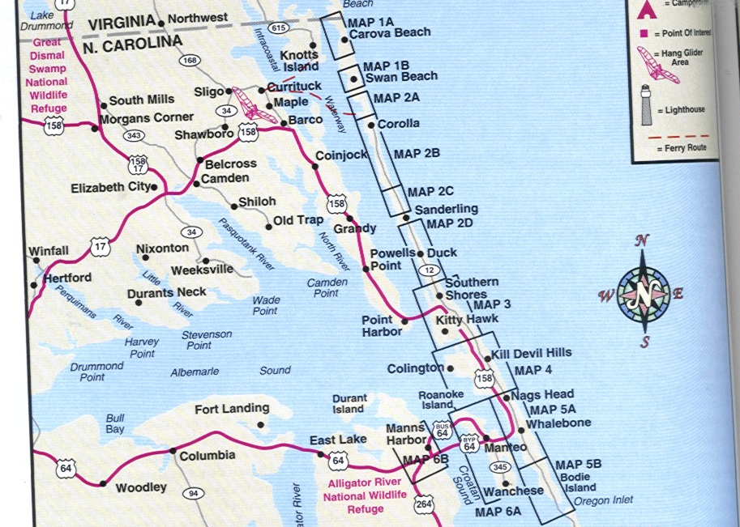
Getting to Carova
Access: Via NC 158 to Rte. 12 N. (20 miles to Corolla)
Keep Going Until the Road Ends (You always wanted to find the end of the road).
Cross onto the Beach. You’ll See the Tire Tracks, there is no other road!
Continue on the beach for 8 miles until you reach Mile Marker 21.
Alternative: View our YouTube video, 6.9 miles to the turn off, 7.7 to the house!
(A Small rectangular green sign at the cut in—easy to miss). Use your odometer
to track the 8 miles and look for the cut that brings you onto Sandfiddler Lane.
You will not see a street sign for Sandfiddler Road from the beach. It’s the
First road parallel to the beach. All roads are sand roads here.
Zoom in to map on PowerPoint

Slide 5
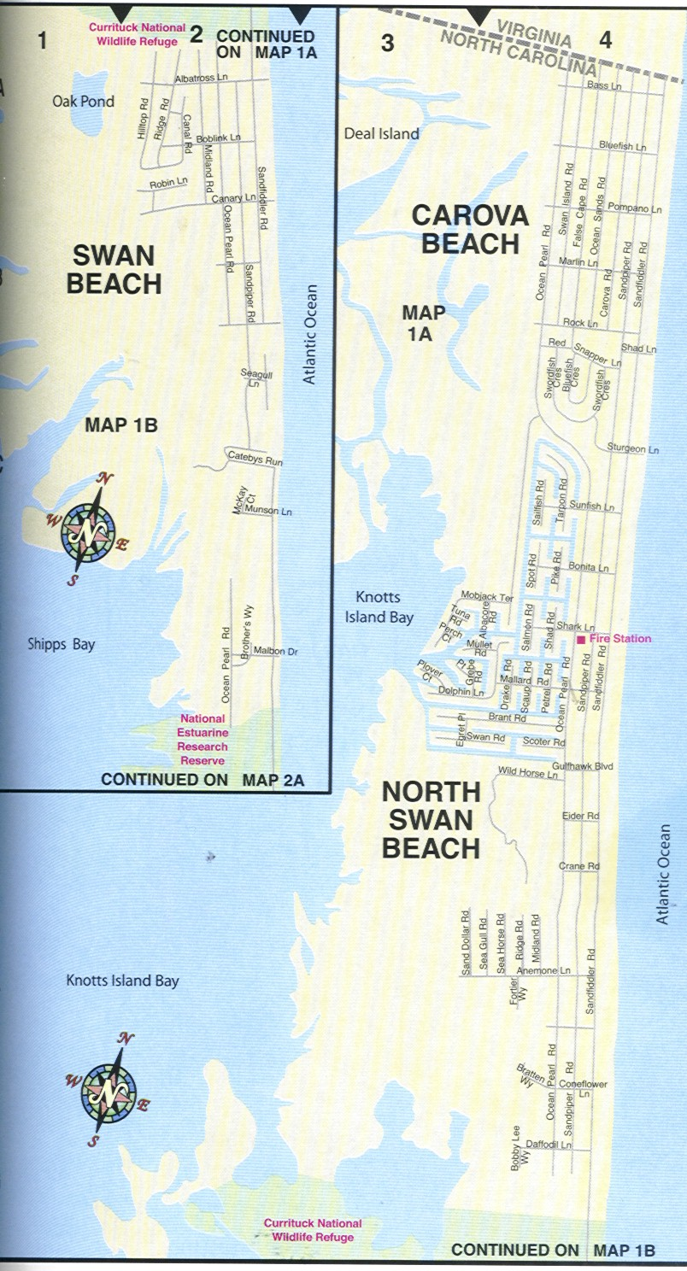
Up the Beach to Carova Heights
At the end of Rte 12, drive right onto the beach. Check your mileage on the
odometer.
Drive 8 miles up the beach. At 8 miles, start looking for Mile Marker 21. Yes, you literally drive on the beach next to the water.
Mile Marker 21 is a green vertical rectangular sign with white numerals. It’s easy to miss. You will see sand roads leading inland. The road before Mile Marker 21 features a small observation tower on stilts.
Sandfiddler Road is the first sand road that runs parallel to the beach. If you come in at Mile Marker 21, you will turn left onto Sandfiddler Road. Carova Heights sits on top of the first hill you approach approx. 200 yds. Down the road and on your right. If you cut in to Sandfiddler by the Observation Tower, you will turn right onto Sandfiddler and 2076 will be on your left. You can also approach the House via Sandpiper Road, the second road parallel to the beach.
We suggest arriving for the first time by daylight. There are no street signs of any kind.
Stock up on groceries and gas before you get on the beach road, you will not find any businesses in Carova, other than at the Fire House.
Drive at low tide when possible. It’s much easier going. You can manage at other times, but at high tide you find deep soft sand. At low tide, it’s like a regular road. (See tide charts below).
Hazards on the beach: tree stumps
If you get stuck in the sand, call A1-Towing or Gene's off road service.
252-453-4002
We have never had to call, but…
Carova Heights

Slide 6
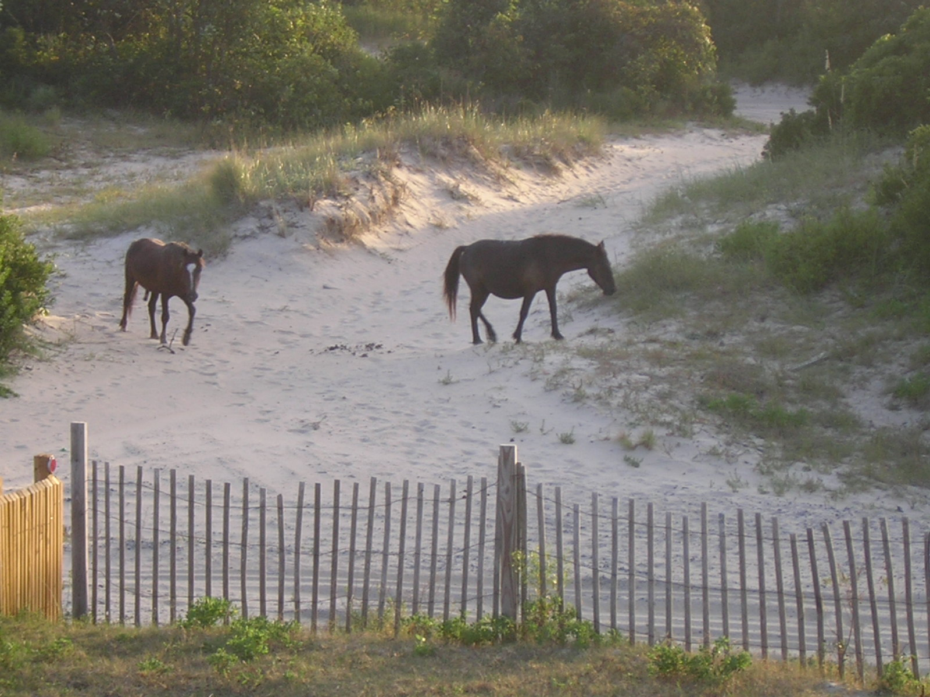
4WD RENTALS & Parking
Rentals: If you want to rent a 4wd
inexpensively we recommend Dollar Rent-a-Car at
the Norfolk Int’l Airport. You can leave your two-wheeler
in long term parking. It should cost $225 to $275 for the week.
On-line: www.dollar.com or call866-434-2226
Parking 2-Wheel Drive Cars: You can park at
A-1 Towing’s lot for $10 per day if the public lot on
Shad Road is full.
A-1: 2051 Ocean Pearl Rd, Corolla, NC
(8.63 miles away) 252-453-4002
Back Roads Eat Tires: Riding the back roads is
great fun, but you will encounter some areas
that destroy tires.
You must keep at least 50 feet from horses
at all times!

Slide 7
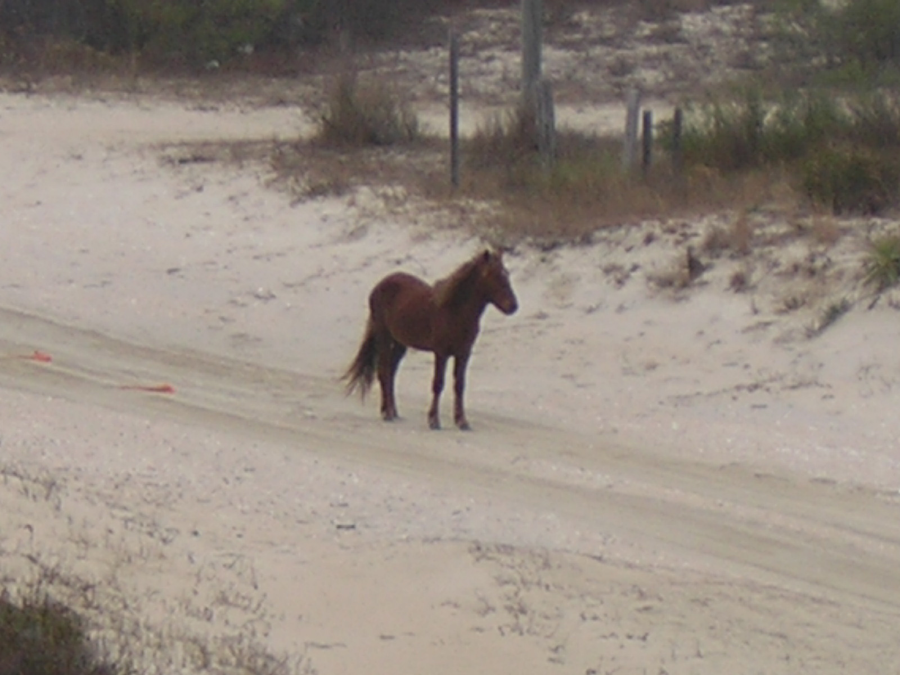
Off Road Driving
Four-Wheel-Driving Tips: Always try to arrive before dark, as the beach is more difficult to navigate at night. Bring a tire pressure gauge. We recommend lowering your tire pressure to 18-25 psi.
Check area tide charts prior to arrival; low tide is ideal for beach driving.
Please follow all posted speed limits
(35 mph, 15 mph when within 300 feet of pedestrians).
Vehicles parked on the beach must be parked in the area east of the dune line and west of the hard packed sand strip, adjacent to the water’s edge.
No chairs, coolers, fishing lines, holes, trenches, or any other items are permitted to block the foreshore.
Operators must be 16 years of age and possess a valid driver’s license.
ATVs are NOT permitted in Currituck county.
Currituck County does not allow personal motorized watercraft on the ocean. Jet skis and personal motorboats are allowed on the Currituck Sound. The closest boat ramp is located at the Whalehead Club in Corolla.
Approximately, when is the best time to travel up the 4x4 beaches?
Low tide is the best time to travel up and down the 4x4 beaches. To view a current tide chart, please follow this link to www.saltwatertides.com.

Slide 8
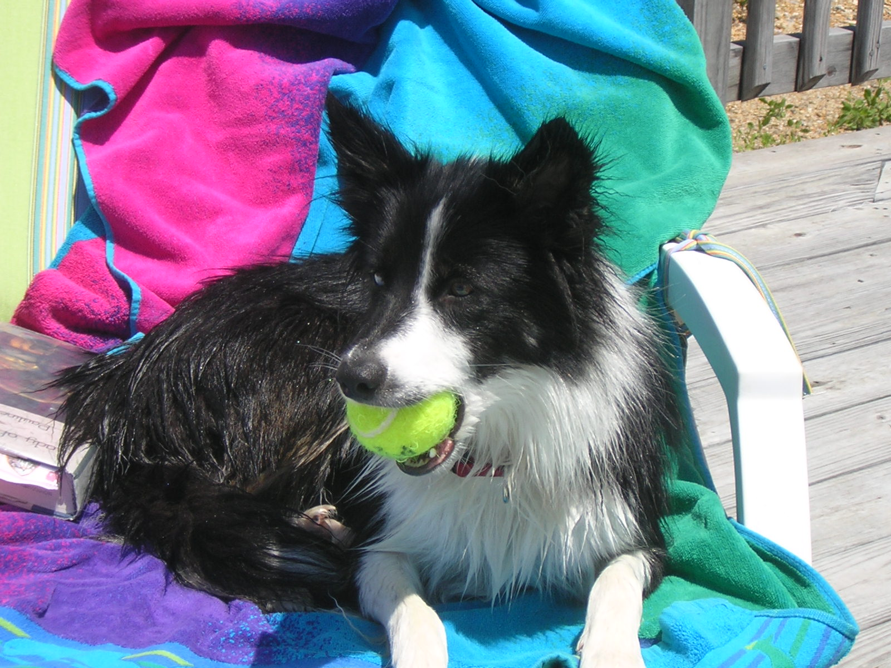

What We Provide
Bed Linens
Bath Towels
Pillows & Blankets,
Dishes/Utensils/Cookware*
Iron & Ironing Board
2 Twin Size AeroBeds (inflatable)
1 baby’s High Chair & Playpen
Appliances:
Coffeemaker
Toaster & Toaster Oven,
Blender
Dishwasher
Microwave
vaccum cleaner -3rd floor
ironing board
broom and dust pan
Outdoor Items:
Outdoor Furniture (including pool furniture)
Outdoor Showers
BBQ Grill (charcoal) + New 6 burner gas grill on pool deck!
Beach Chairs
2 Carports (sheltered)
Equipment/Services:
CD player
Telephone (local service only)
Satellite Based Internet/Wifi
Dishnet TV & DVD player
Washer/Dryer
Central Heat & Air
Pet Items:
Sofa Covers
2 dog bowls
2 dog beds
Enclosed pet run
Dog chews & some toys
Incl. tennis balls.
1 large metal dog crate
2 soft crates, Lge. Med.
Garbage & Recycling Cans
* Incl. glasses, dishes, utensils, BBQ tools,
pots, pans, coffee pot, grinder.
If you do not find linens
or other items listed here
please call Ramona Parsons
(757) – 375-2116 cell

Slide 9
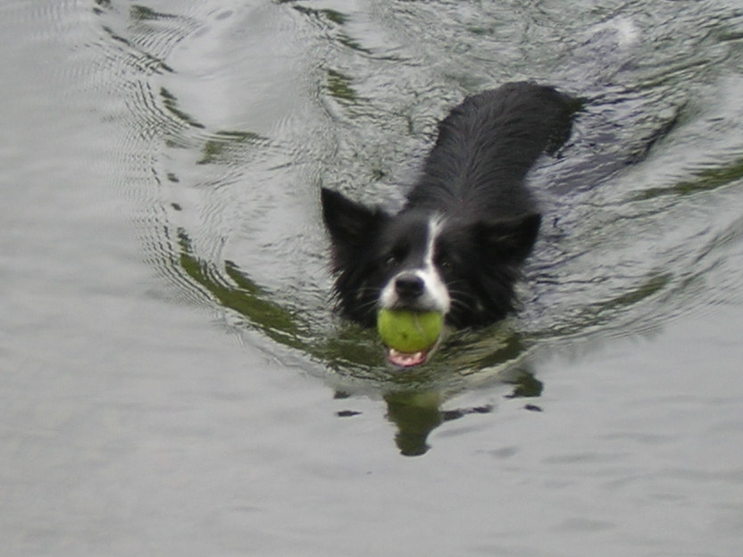
What to Bring
Toilet paper
paper towels
Napkins
Spices & Foodstuffs
garbage bags
dishwashing liquids
Laundry Detergent
soap
laundry detergent
crib sheets
extra beach towels
Laptop computers
Linens for cribs & portacribs
We do not supply game stations, video games, x-boxes, etc. but we do have puzzles and Scrabble!
Ramona Parsons works into the early evening. If your linens have not been delivered by around 4:30 pm, Ramona Parsons (757) – 375-2116 cell
note: we also use the Carova Heights and we often leave some of the items listed above. You are most welcome to use these products, but please be aware that these are items that our Guests normally provide themselves.

Slide 10
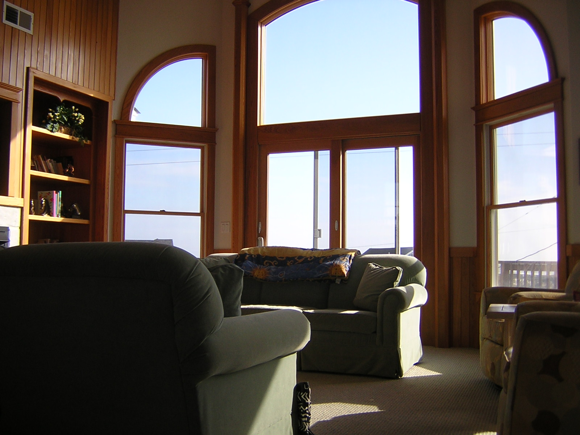
On Arrival: Keypad , Unloading, Inspection
Unloading:
We have a second refrigerator
On the first floor, a good place
For water and beverages. The
Kitchen is on the third level.
Lock Box:
Access to Key at Front Door
Call Tab for the Code
Check-in time is 4:00 - 5:00 pm. We try to have homes ready by check-in time, but the unforseen sometimes trumps our plans. Housekeeping and maintenance personnel, Ramona Parson and Skeeter Esposito, provide services between occupancies. If you must arrive early, please let them know in advance. Linen deliveries, pool & spa cleaning and some maintenance may not be completed before Check-In and service people may arrive in the afternoon and early evening. Please work with them. Check your bedding, and make sure everything is ship shape. Report problems to Ramona or Skeeter at #s provided on the Fridge.

Slide 11
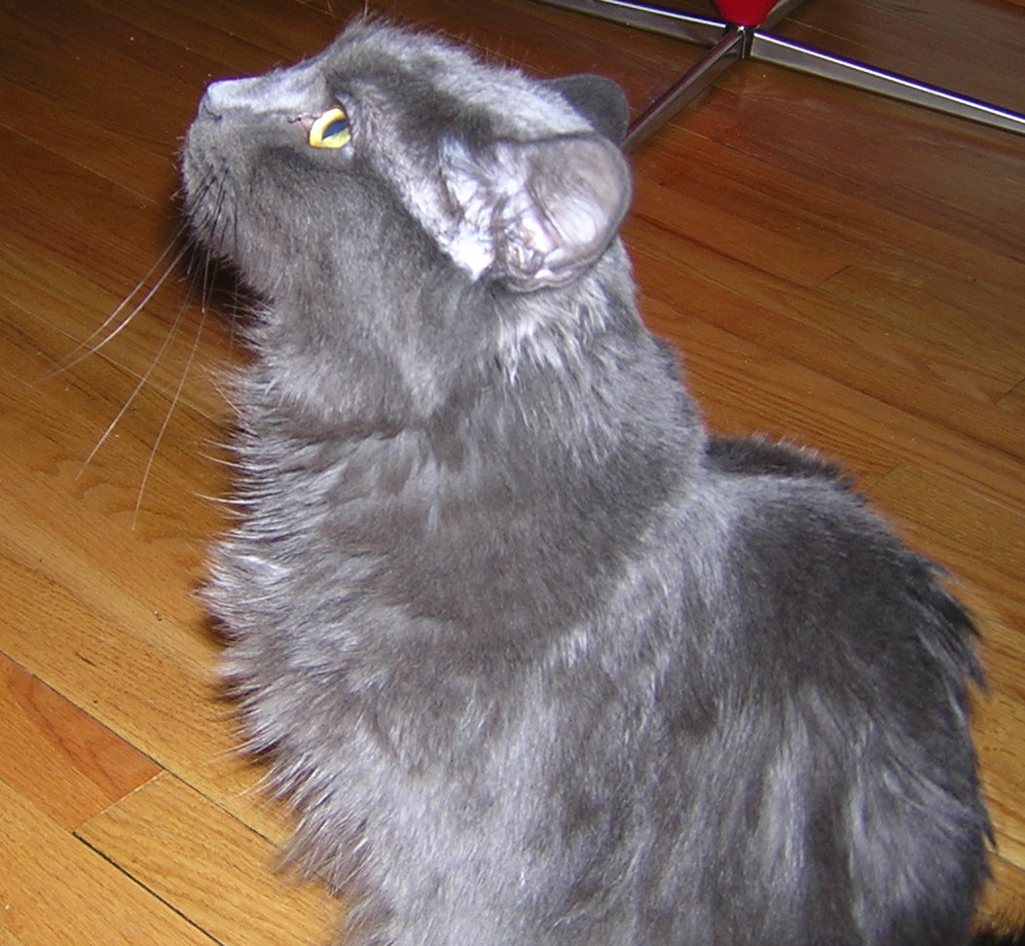
Things to Know
WATER: At times the well emits no water. Check again in 5 minutes, you should have it back. This is normal, but the area does suffer water shortages. Please conserve when you can, and do not run water unnecessarily.
SERVICES: Severe weather can interrupt satellite service for tv & internet.
TELEPHONE: For long distance, use a calling card or your cell phone.
CRITTERS: You’re sharing an environment rich is wildlife, and from time to time, critters like mice, snakes, and even a wild horse may wander inside. Answer: don’t leave doors open!
WALKING: Sand fencing protects the dunes, please do not walk over or near fenced areas. The best way to walk to the beach is down the driveway and out on Eider Road. We have an easement that permits us to walk straight onto the beach. (See Beach Access slide).
STOVE: Flat surfaces for all four burners, and if you leave them on accidentally…please be careful.
DOORS: When using a/c please keep doors and windows shut. The environment will thanks you. So will we!
FRESH AIR: Sliding screen doors let in a constant ocean breeze and keep out bugs and other critters.
SUN DRY TOWELS: Feel free to hang your towels from the deck rails and in the sun to dry. Works like a charm.
Carova Beach T-Shirts, caps and apparel available for sale at the Fire House, the only retail, commercial place in Carova.

Slide 12


Emergency & Contact Numbers
EMERGENCY: 9-1-1
Carova Beach Volunteer Fire Department, Inc.
P.O. Box 20
Corolla, NC 27927
Phone: 252-453-8690
Fax: 252-453-8659
EMERGENCY MEDICAL SERVICES:
Phone: 252-232-7746
Fax: 252-232-0015
The Outer Banks Hospital
(252) 449-4500
(877) 359-9179.
4800 S. Croatan Highway
Nags Head, NC 27959.
MAINTENANCE/REPAIRS
Skeeter Esposito
(757) 619-8817 Cell
HOUSEKEEPING
Ramona Parsons
(757) – 375-2116 cell
TRASH & PROPANE
Gene's Off Road Services
2010 Sandfiddler Road
Corolla, NC 27927
252-453-4160
OWNERS
Bob Honig
(301) 580-1917
Rande Joiner
(202) 328-3300
Carova Heights Land Line (252) 457-0817
Email: rentals@carovaheights.com
RECYCLING CENTER
2020 Ocean Pearl Road
Towing on the Beach?
A1 Towing
453-4002
INTERNET or TV PROBLEM?
Call Bob or Rande

Slide 13
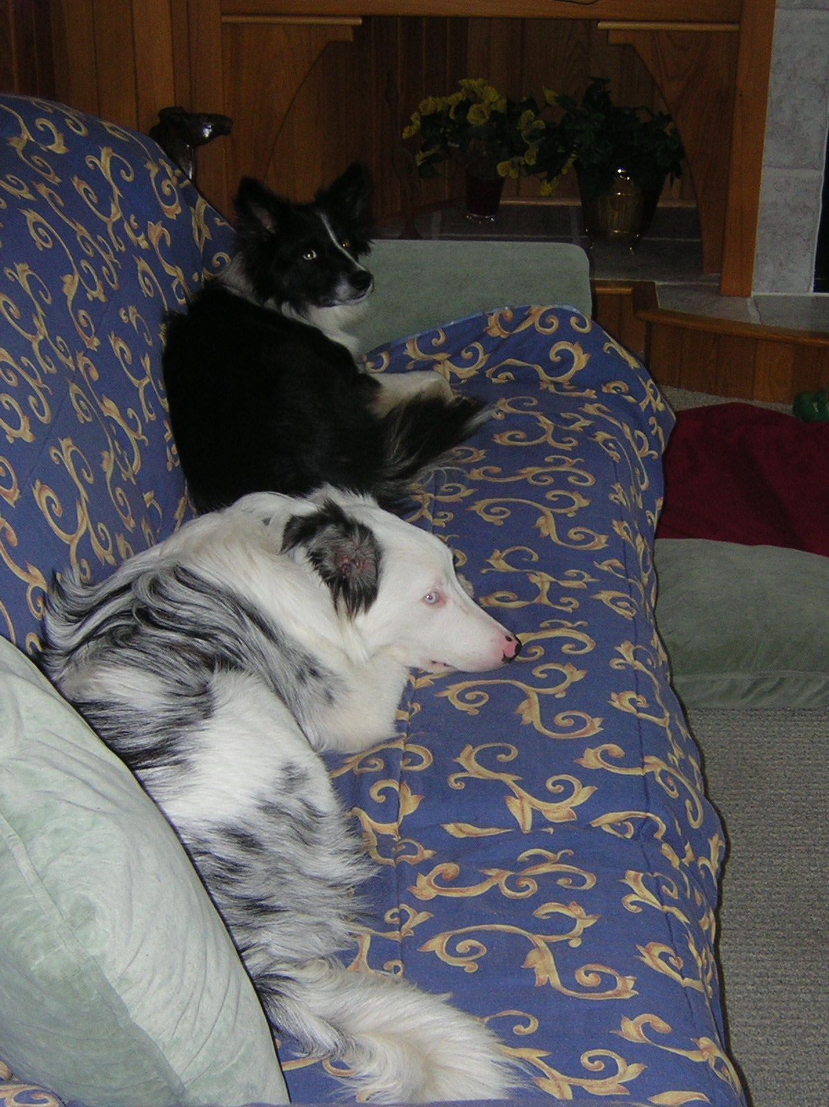
Pet Policy
1. Dogs should not be left unattended or unsupervised in the house for any period of time.
2. Please provide appropriate chew sticks or bones for your pet at the beach house.
3. Flea and tick preventative such as Frontline Plus, noone wants fleas or ticks.
4. All pets must have rabies and distemper vaccinations, be spayed or neutered.
5. Shut bedroom doors during the daylight hours.
6. Please do not leave uneaten dog or pet food on the floor overnight. Bugs, mice, yuk!
7. We prefer not to have pets on the furniture, but if this is not an option, there are old bedspreads in the closet near the front entrance that can be used to cover some furniture, and we will provide washable covers for the great room furniture. Please take these off the furniture at your departure, and leave them on the washing machine on the lower level.
8. No dogs on the beds please.
9. No dogs in the hot tub for their safety and yours. Ditto for indoor Jacuzzi tubs.
10. Please rinse off your dog (1) before entering the gated pool area and (2) before entering the house.
11. Towel dry the dog before letting him/her into the house. A fluffy towel by the front door works.
12. Dogs like to cool off or swim in the pool, but please be sensible and supervise your dog.
13. Accidents happen. A special enzyme solution (for odor) and carpet cleaner are under the kitchen sink. You should mark areas that do not clean up with a white piece of paper with an arrow.
14. Dogs are allowed on the beach. Cars and horses present a real danger. Do not just loose the hound!
15. Your pet is your responsibility while at Carova Heights and by agreeing to our terms and conditions, you agree to hold us harmless and waive any and all liability for injury to your pet or others.
- o

Slide 14
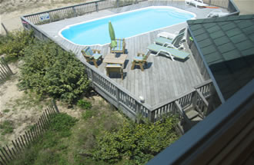
Pool & Hot Tub
Pool/Hot Tub/Jacuzzi. You have agreed to use the pool, hot tub and Jacuzzi in a responsible and safe manner. As nearly all pools in private homes, we do not provide a lifeguard. That makes the adults in your party your lifeguards. Adults must supervise children under the age of 18 at all times in the pool, hot tub or Jacuzzi.
Although you’ve released us from liability, we want you to be safe.
We do our best to ensure that the pool is properly clean, and Tab Winborne does this service for each tenant. But the pool is out in the
open and the steps leading into the pool can become slick.
You will find comfortable pool furniture, and we’re working to improve
pool side amenities in the very near future.
Please use common sense, and follow the same rules that apply
at your local pool, I.e. running on the deck, aggressive horsing
around, diving off the sides can cut your vacation short in a heartbeat.

Slide 15
Do’s and Don’t’s
RECYCLING : We recycle. We recommend it, but do not insist.
SPILLS: If you spill food or drink on carpet or furniture and it won't come clean, contact Tab immediately.
IT BREAKS OR WON’T WORK: Things we use will break. Please let Tab know if something doesn’t work so that he can fix it.
Do not try to fix anything yourself, we beg of you!
BEACH EASEMENT: as our guests you are allowed to walk across the property in front of the house to access the beach. At the intersection of Eider and Sandfiddler you will see vertical white PVC pipes that mark the opening to the easement. You will find an animal trail that takes you between the dunes. Please use it.
HORSES: Do not feed the horses! Stay at least 50 ft away from them. Yes, they will come close, and even onto the property. Do your best. Young foals lay complete flat on their sides. They are fine. Learn more at: www.corollawildhorses.com.
GUESTS sometimes try to rearrange furniture, especially the pool table. Please refrain from doing anything that might injure you or the property.
We do not permit ATVs on the premises, illegal in Currituck.
OH NO! If you arrive and the you the premises in disarray or
discover broken windows, screens, door locks, or anything amiss,
please call Tab asap or call the owners—one of us. Don’t let it go. We will work with you to solve problems promptly, but if we can’t,
we’ll adjust your payment.

Slide 16
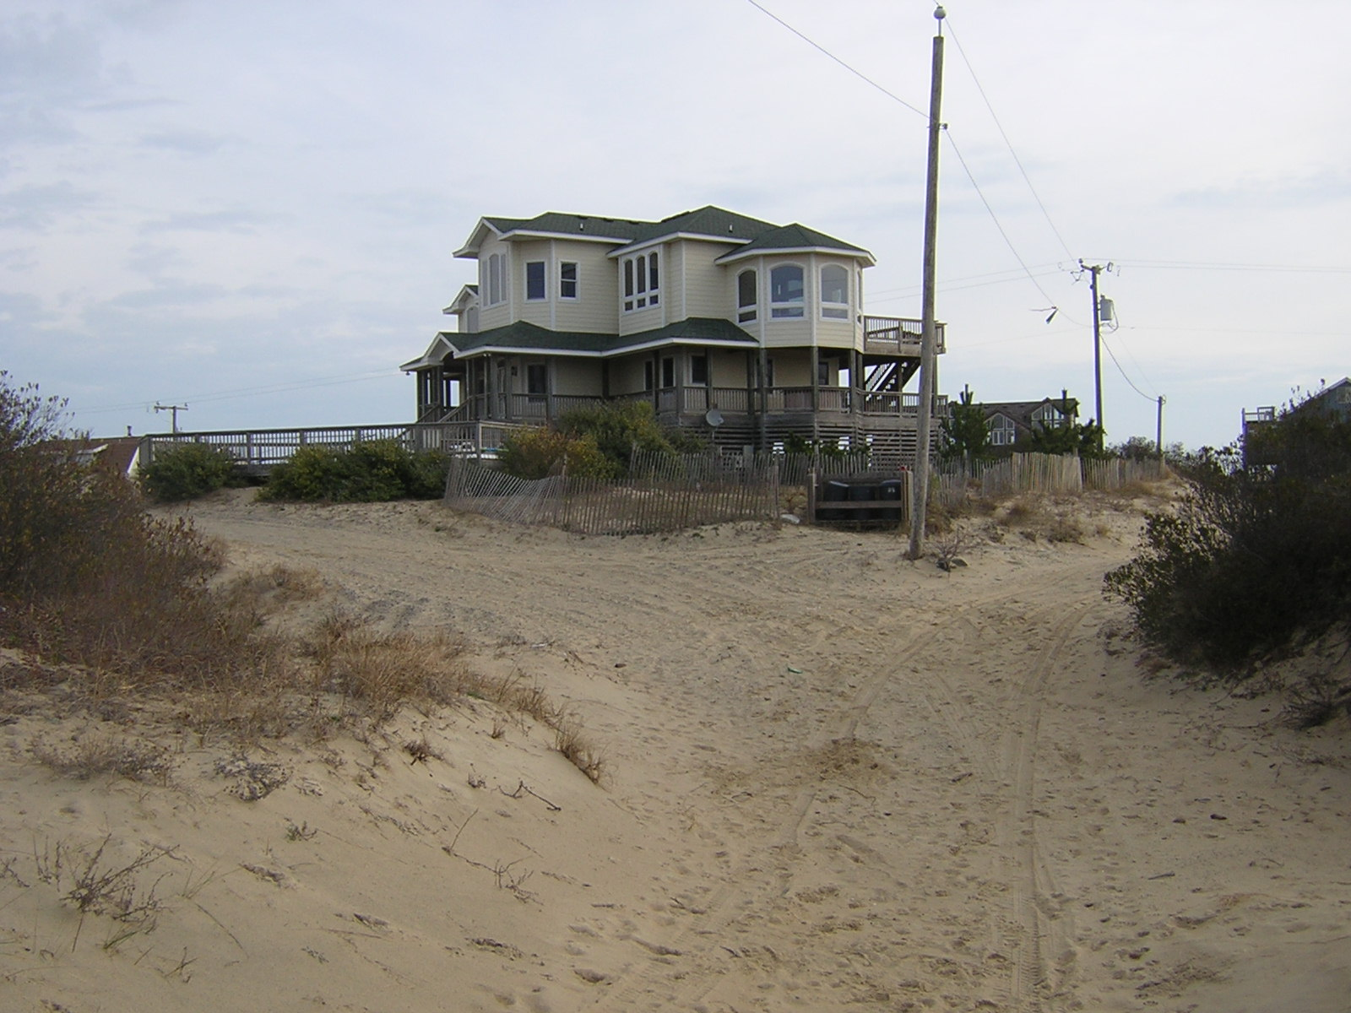
Check Out & Prep
Leaving Carova Heights as you found it helps everyone. We can return your entire deposit, and the next guest can enjoy their stay as much as you have.
Close and lock all windows and doors.
Set thermostat to 75 degrees for AC or 55 degrees for heat.
Leave linens on the beds and towels in the bathrooms
Clean the grill with the brush provided.
Tidy up the pool area, deck and yard. Put key back in lock box.
Place all trash in exterior cans
Remove all food from the refrigerator & wipe clean and adjust thermostat to the mid-level setting.
Load and start the dishwashers or wash dishes and re-shelve.
Clean kitchen countertops
Broom sweep rooms and straighten up.
Wash any badly soiled bed spreads.
.
CHECK OUT.
10:00 am is check-out time.

Slide 17
Finding the Fun Stuff
OUTER BANKS DOINGS
For the skinny on other activities: Outer Banks Chamber of Commerce (252) 441-8144, Outer Banks Visitors Bureau (877) OBX-4FUN, North Carolina Visitor Information (800) VISIT-NC, or Currituck County Chamber of Commerce (877) CURRITUCK.
Where is the closest public boat ramp? The closest public boat ramp is located at the Whalehead Club in Corolla, open from sunrise until dusk. Due to shallow water and grass, this ramp is suitable for small craft only. Pirate's Cove Marina in Manteo is suited for larger water craft.
HOUSE CALLS Medical House Calls - Treatment of minor illnesses in your rental home - (252) 475-2007, The Outer Banks Hospital - located at milepost 14 in Nags Head - (252) 449-4500
Where is the closest grocery store? Food Lion is located in Corolla. Harris Teeter serves the gourmet palate just south of Corolla on Rte. 12. From Carova Heights, figure on a half hour drive.
GOLF ANYONE? The Currituck Club, Corolla (888) 453-9400 or (252) 453-9400- http://www.thecurrituckclub.com; Duck Woods Country Club, Southern Shores (252) 261-2609; Sea Scape Golf Club, Kitty Hawk (252) 261-2158- http://www.seascapegolf.com; The Pointe Golf Club, Powell’s Point (252) 491-8388 - http://www.thepointegolfclub.com; Holly Ridge, Point Harbor (252) 491-2893; Kilmarlic Golf Club, Point Harbor (252) 491-4220- http://www.kilmarlic.com;
GONE FISHING? Yes, a Coastal Recreational Fishing License is required for all anglers who recreationally fish in coastal waters in North Carolina (effective January 1, 2007). 10-day, annual or lifetime basis, or combined with licenses issued by the Wildlife Resources Commission. Fishing licenses may be purchased from any Wildlife Resources Commission agent (includes most bait and tackle shops), online at www.ncwildlife.org, at any Division of Marine Fisheries at 252-726-7021 or by calling toll-free 888-248-6834. For complete licensing information, please visit www.ncfisheries.net or call the Division of Marine Fisheries at 252-726-7021 or 800-682-2632. The Annual License Fee is $15 for State Residents, age 16 or older and $30 for nonresidents, age 16 or older. The 10-day License Fee is $5 for State Residents, age 16 or older and $10 for nonresidents, age 16 or older.

Slide 18
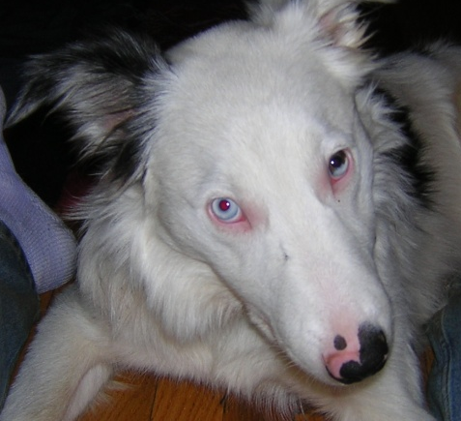
Travel Insurance
PLAY SMART
You should never lose a non-refundable deposit. We recommend that you buy Travel Insurance that includes coverage for medical emergencies and cancellation insurance for a mandatory evacuation due to hurricanes. This insurance covers the rental rate and taxes paid for the home you reserve. We strongly urge you to purchase this coverage to cover your vacation investment, as no refunds will be offered, even in the case of a mandatory evacuation. You can find plans at:
www.insuremytrip.com/products-1000-0-30002-15220.html, http://www.accessamerica.com, and Travel Guard at www.travelguard.com which is offered to renters in this area. The Policies will contain reductions, limitations, exclusions and termination provisions.
Border Collies
Always
Play Smart

Slide 19
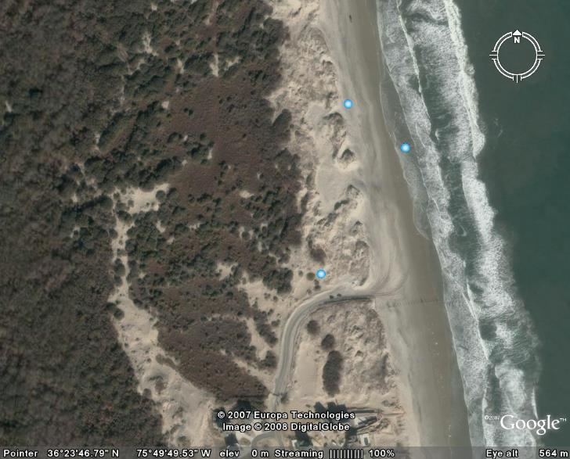
Overview of 4WD Beach Entry
Rte 12 ends
An aerial view of where Rte 12 ends
and the beach road begins

Slide 20
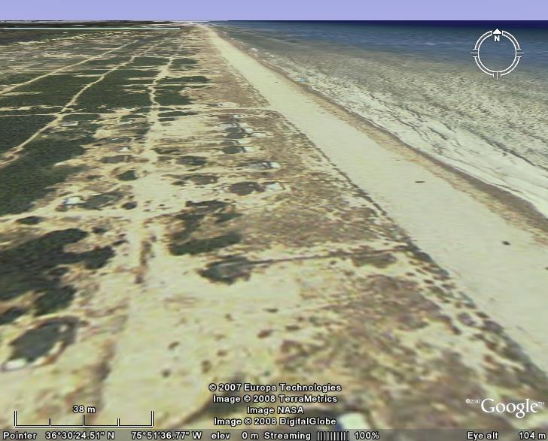
Beach Access
Carova Heights
Beach Access Via Easement Less Than
100m from the beach.

Slide 21
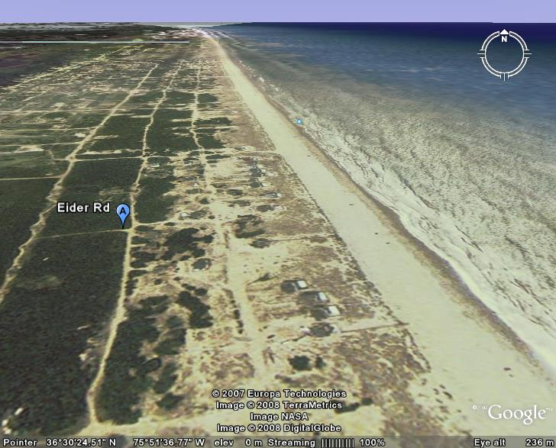
Carova Heights Surroundings
Carova Heights
Sandfiddler Road

Slide 22
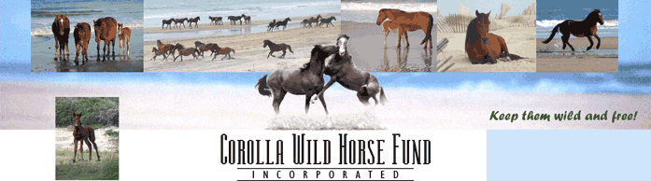
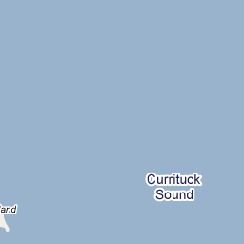


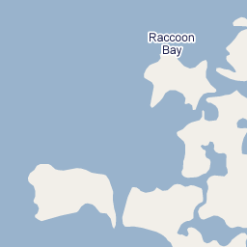
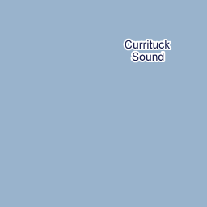

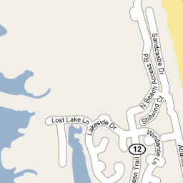
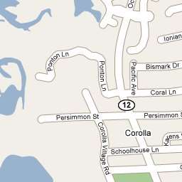
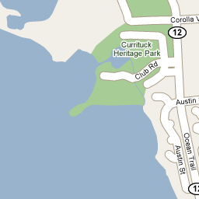
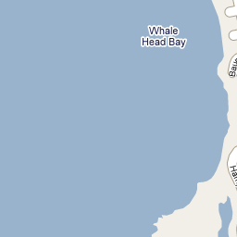
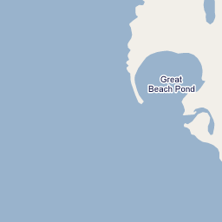
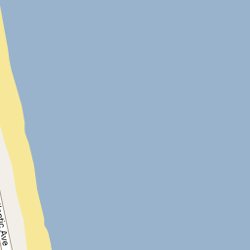
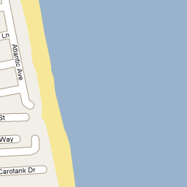
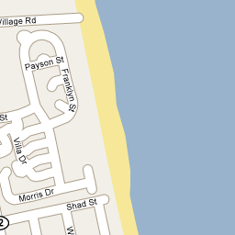
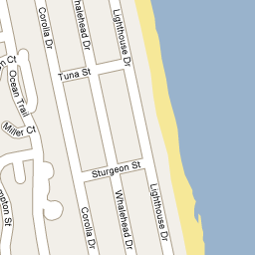
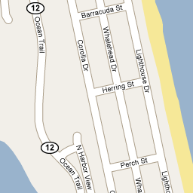








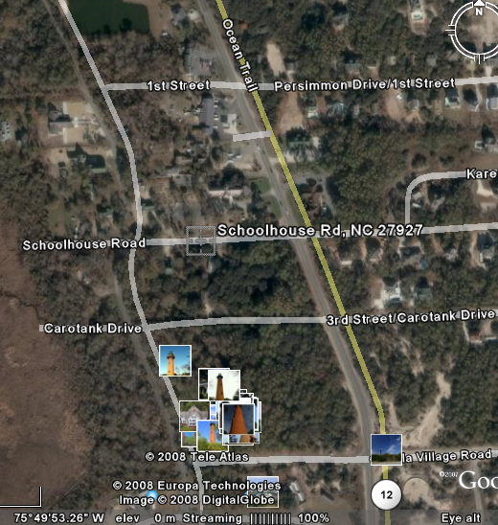
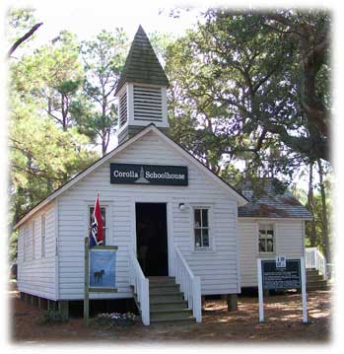
Saving the Horses
©2008 Google - Map data ©2008 NAVTEQ™ - Terms of Use
©2008 Google - Map data ©2008 NAVTEQ™ - Terms of Use
200 m
200 m
1000 ft
1000 ft
Corolla, NC 27927
Corolla, NC 27927
Make this my default location
Make this my default location
Popular searches near this location
Popular searches near this location
We have books and a DVD on Carova’s wild horses produced by the Corolla Wild Horse Fund. By the way, the natives pronounce Corolla “Kah-rah-lah”. When the County extended Route 12 to Corolla in the late 1980s, motorists began to strike and kill horses, Particularly at night. Concerned local citizens banded together and formed the Corolla Wild Horse Fund. To save the horses, they rounded up the herd and drove them north to Carova Beach. Unhappily development continues
to threaten the herd, including road improvement programs. We can’t imagine Carova Beach without its horses, and we whole heartedly support the Fund. We hope you will take the opportunity to learn about the Spanish Mustangs and to visit the Wild Horse Museum on Schoolhouse Road in Corolla. (See map below left). It’s next to the Curritick Light House, another landmark worth visiting. The museum sells a variety of apparel and other items that support the mission.
norfolk airport
norfolk airport
grocery stores
golf
currituck beach lighthouse
harris teeter
outer banks
beer
inn at corolla lighthouse
seafood
twiddy
grocery stores
golf
currituck beach lighthouse
harris teeter
outer banks
beer
inn at corolla lighthouse
seafood
twiddy
1126 Old Schoolhouse Lane /
Corolla, NC. 27927 / (252) 453-8002
email: info@corollawildhorses.com

Slide 23



3rd Floor Plan
Bathroom
Jacuzzi
Walk-in
Shower
Master Bedroom Suite
(King Bed)
POWDER
ROOM
Captain’s Lookout
(Raised Area W. SOFABED)
Stairs
Living & Entertainment
Ocean Side
Kitchen
Dinning Area
Sound Side
Card Table & Sunset Room

Slide 24
2nd Floor Plan
Kids Bedroom
Bunk Beds
(1 twin, 1 full)
Shared Bath
Tub/Shower
Bedroom
2 Twin Beds
To basement
Bath
Tub/Shower
To 3rd Flr
Hallway
Front Door
Foyer
Bedroom
Queen Bed
Closets
Bath
Jacuzzi & Walk-in
Shower
2nd Master Bedroom Suite
King Bed

Slide 25

1st Floor Plan
Owners
Closets
Sink
& 2nd Fridge
Laundry
Washer & Dryer
Carport
Furnace
A/c
Carport
Bedroom
Queen Bed
Bath
Tub & Shower
Game Room
(Pool Table)

